Slide 1
Calculo Numérico I Raíces de ecuaciones: Métodos Cerrados
Dr. Luis Sanchez

Slide 2
Objectives:
Understanding what roots problems are and where they occur in engineering and science.
Knowing how to determine a root graphically.
Knowing how to solve a roots problem with the bisection method.
Understanding false position and how it differs from bisection.
Understanding the incremental search method.

Slide 3
Roots of Equations
A number r that satisfies an equation is called a root of the equation.

Slide 4
Zeros of a Function
Let f(x) be a real-valued function of a real variable. Any number r for which f(r)=0 is called a zero of the function.
Examples:
2 and 3 are zeros of the function f(x) = (x-2)(x-3).

Slide 5
Roots of Equations & Zeros of Function

Slide 6
Solution Methods
Several ways to solve nonlinear equations are possible:
Analytical Solutions
Possible for special equations only
Graphical Solutions
Useful for providing initial guesses for other methods
Numerical Solutions
Open methods
Bracketing methods

Slide 7
1. Analytical Methods
Analytical Solutions are available for special equations only.

Slide 8
2. Graphical Methods
First Way:
Graphical methods are useful to provide an initial guess to be used by other methods.
Root
2
1
1 2

Slide 9
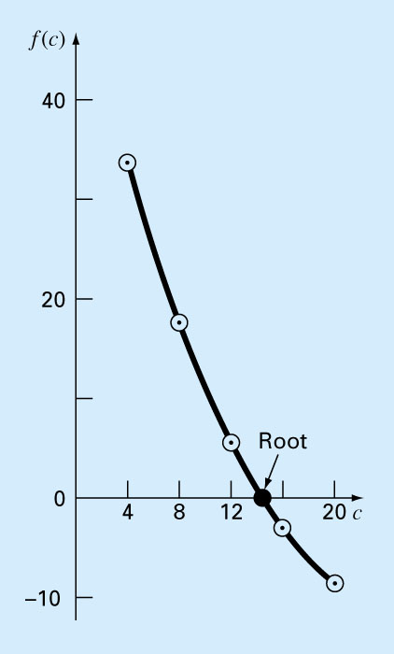
2. Graphical Methods
Second Way
A simple method for obtaining the estimate of the root of the equation f(x)=0 is to make a plot of the function and observe where it crosses the x-axis.
Graphing the function can also indicate where roots may be and where some root-finding methods may fail.

Slide 10
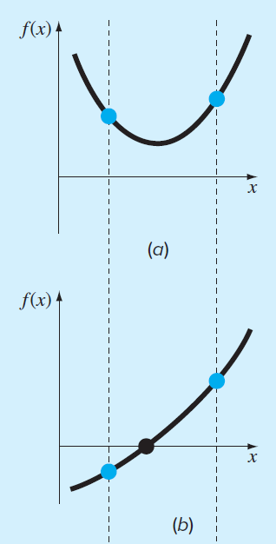
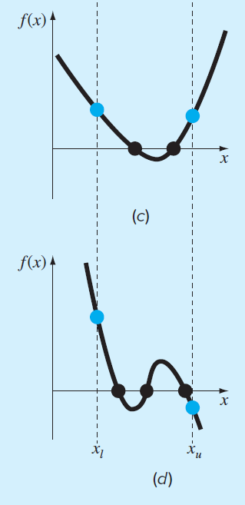
General rule for number of roots in an interval

Slide 11
General rule for number of roots in an interval
(a) Same sign, no roots
(b) Different sign, one root
(c) Same sign, two roots
(d) Different sign, three roots

Slide 12
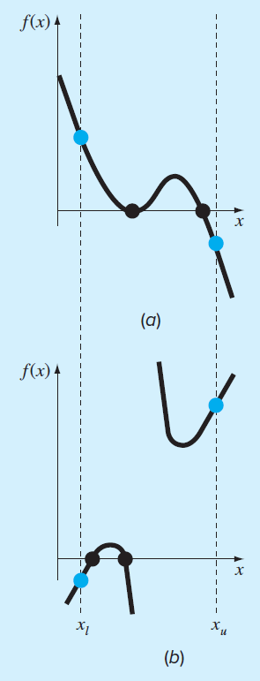
General rule for number of roots in an interval: Some exceptions
(a) Multiple roots
f(x) = (x-2)(x-2)(x-4)
(b) Discontinuous function

Slide 13
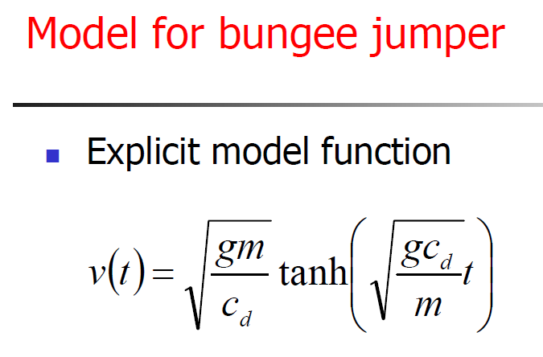
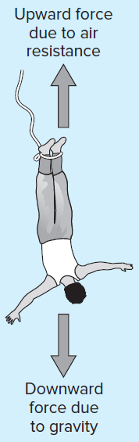
Example 01
Use the graphical approach to determine the mass of the bungee jumper with a drag coefficient of 0.25kg/m to have a velocity of 36m/s after 4 s of free fall. The acceleration of gravity is 9.81m/s².

Slide 14
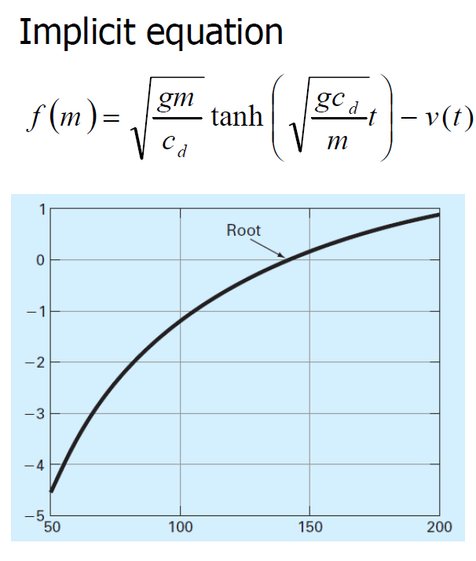
In Matlab
cd = 0.25;
g = 9.81;
v = 36;
t = 4;
mp = linspace(50,200);
fp = sqrt(g*mp/cd).*tanh(sqrt(g*cd./mp)*t)-v;
plot(mp,fp),grid

Slide 15
3. Numerical Methods
Many methods are available to solve nonlinear equations:
Bisection Method
False Position Method
Newton’s Method
Secant Method
Bracketing Methods
These will be covered in Next Class

Slide 16
3.1. Bracketing Methods
In bracketing methods, the method starts with an interval that contains the root and a procedure is used to obtain a smaller interval containing the root.
Examples of bracketing methods:
Bisection method
False position method

Slide 17
3.2. Open Methods
In the open methods, the method starts with one or more initial guess points. In each iteration, a new guess of the root is obtained.
Open methods are usually more efficient than bracketing methods.
They may not converge to a root.

Slide 18
3.1.1. Bisection Method
The Bisection method is one of the simplest methods to find a zero of a nonlinear function.
It is also called interval halving method.
To use the Bisection method, one needs an initial interval that is known to contain a zero of the function.
The method systematically reduces the interval. It does this by dividing the interval into two equal parts, performs a simple test and based on the result of the test, half of the interval is thrown away.
The procedure is repeated until the desired interval error is obtained.
Notes:
Convert to Speech:
The Bisection method is one of the simplest methods to find a zero of a nonlinear function.
The method is also called interval halving.
To use the Bisection method, you need an initial interval that is known to contain a zero of the given nonlinear function..
The method systematically reduces the interval.
Bi means two and bisection means divide into two. This is basically what the procedure is doing. It divides the interval into two equal parts, performs a simple test and based on the result of the test half of the interval is thrown away.
The remaining half is divided into two and the test is applied again and the procedure is repeated until the desired interval size is obtained.

Slide 19
Intermediate Value Theorem
Let f(x) be defined on the interval [a,b].
Intermediate value theorem:
if a function is continuous and f(a) and f(b) have different signs then the function has at least one zero in the interval [a,b].
f(a)
a
b
f(b)

Slide 20
Examples
If f(a) and f(b) have different signs, the function has at least one real zero.
Bisection method can be used to find one of the zeros.
a
b
The function has one real zero
a
b
The function has three real zeros
Notes:
Convert to Speech:
if the function is continuous and ef of ay and ef of be have different signs then the functions has at least one zero and the Bisection method can be applied to find a zero of the function.

Slide 21
Bisection Method
Assumptions:
Given an interval [a,b]
f(x) is continuous on [a,b]
f(a) and f(b) have opposite signs.
These assumptions ensure the existence of at least one zero in the interval [a,b] and the bisection method can be used to obtain a smaller interval that contains the zero.
Notes:
Convert to Speech:
The assumptions are:
Given an interval ae be
The function is continuous on the interal
And the values of ef of a and ef of be have different signs.
These assumptions ensures the existence of at least one zero in the interval [a,b] and the bisection method can be used to obtain a smaller interval that contains the zero.

Slide 22
Bisection Algorithm
Assumptions:
f(x) is continuous on [a,b]
f(a) f(b) < 0
Algorithm:
Loop
1. Compute the mid point c=(a+b)/2
2. Evaluate f(c)
3. If f(a) f(c) < 0 then new interval [a, c]
If f(a) f(c) > 0 then new interval [c, b]
End loop
f(a)
c
b
a
f(b)
Notes:
Convert to Speech:
Assuming that the function is continuous on ay be and ef of ay times ef of be is negative. The Bisection algorithm is an iterative procedure that obtains a new interval that is guaranteed to contain a zero of the function.
In each iteration, the first step is to obtain the middle point in the interval then evaluate the function at the mid point. In the third step the new interval is obtained based on the sign of ef of ay times ef of see. If this product is negative then the new interval is ay see otherwise the new interval is ay be.
And the procedure is repeated

Slide 23
Stopping Criteria
Two common stopping criteria
Stop after a fixed number of iterations
Stop when the error is less than a specified value
Notes:
Convert to Speech:
Two commonly used way to stop the Bisection method.
Stop after a given fixed number of iterations
Or
Stop when the error is less than a specified value.
In fact if one is given the initial interval and the error level, the number of iterations needed to achieve this accuracy can be calculated easily. Similarly if the initial interval and the number of iterations are given then one can obtain an upper bound on the resulted error.

Slide 24
Flow Chart of Bisection Method
Start: Given a,b and ε
u = f(a) ; v = f(b)
c = (a+b) /2 ; w = f(c)
no
yes
is
u*w <0
no
is
(b-a) /2<ε
Stop
yes
b=c; v= w
a=c; u= w
Notes:
Convert to Speech:
A detailed flow chart of the Bisection algorithm is shown. The program starts with ay , be and epsilon.
Ae and be, the end points of the interval and epsilon is the accuracy level.
The function is evaluated at the end points and the values are stored in u and v.
In each iteration, the middle point c is computed and the function is evaluated and its value is stored in w.
If W times u is negative, That is ef of a times ef of c is negative then the new interval is ay see .
Otherwise the new interval is be see
A stopping criterion is used here. If the size of the interval is less than a desired accuracy level the algorithm is stopped, otherwise the procedure is repeated.

Slide 25
Implement a funtion M file to use bisection to solve the same problem approached graphically of the bungee jumper.
Example
function [root,fx,ea,iter]=bisect(func,xl,xu,es,maxit,varargin)
% bisect: root location zeroes
% [root,fx,ea,iter]=bisect(func,xl,xu,es,maxit,p1,p2,...):
% uses bisection method to find the root of func
% input:
% func = name of function
% xl, xu = lower and upper guesses
% es = desired relative error (default = 0.0001%)
% maxit = maximum allowable iterations (default = 50)
% p1,p2,... = additional parameters used by func
% output:
% root = real root
% fx = function value at root
% ea = approximate relative error (%)
% iter = number of iterations
if nargin<3
error('at least 3 input arguments required');
end
test = func(xl,varargin{:})*func(xu,varargin{:});
if test>0
error('no sign change');
end
if nargin<4||isempty(es)
es=0.0001;
end
if nargin<5||isempty(maxit)
maxit=50;
end
iter = 0;
xr = xl;
ea = 100;
while (1)
xrold = xr;
xr = (xl + xu)/2;
iter = iter + 1;
if xr ~= 0
ea = abs((xr-xrold)/xr) * 100;
end
test = func(xl,varargin{:})*func(xr,varargin{:});
if test < 0
xu = xr;
elseif test > 0
xl = xr;
else
ea = 0;
end
if ea <= es || iter >= maxit
break;
end
end
root = xr; fx = func(xr, varargin{:});
fm=@(m) sqrt(9.81*m/0.25)*tanh(sqrt(9.81*0.25/m)*4)-36;
[mass fx ea iter]=bisect(fm,40,200);

Slide 26
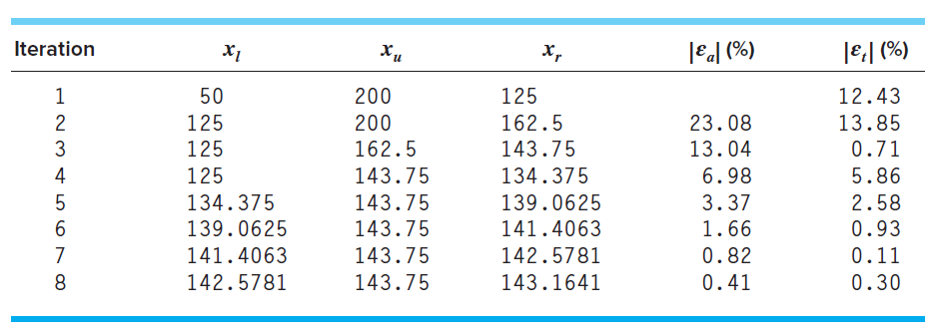
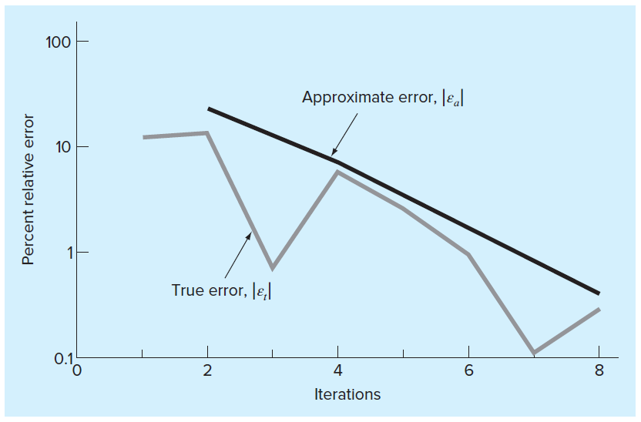

Slide 27
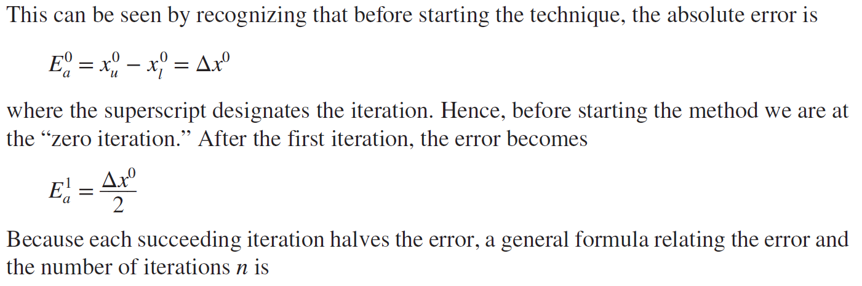
Bisection Error
The absolute error of the bisection method is solely dependent on the absolute error at the start of the process (the space between the two guesses) and the number of iterations:

Slide 28
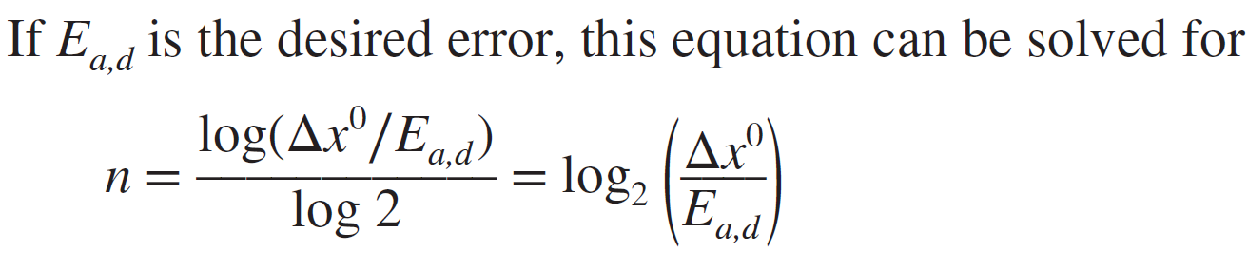
Bisection Error
The required number of iterations to obtain a particular absolute error can be calculated based on the initial guesses:

Slide 29
Bisection Method
Advantages
Simple and easy to implement
One function evaluation per iteration
The size of the interval containing the zero is reduced by 50% after each iteration
The number of iterations can be determined a priori
No knowledge of the derivative is needed
The function does not have to be differentiable
Disadvantage
Slow to converge
Good intermediate approximations may be discarded

Slide 30
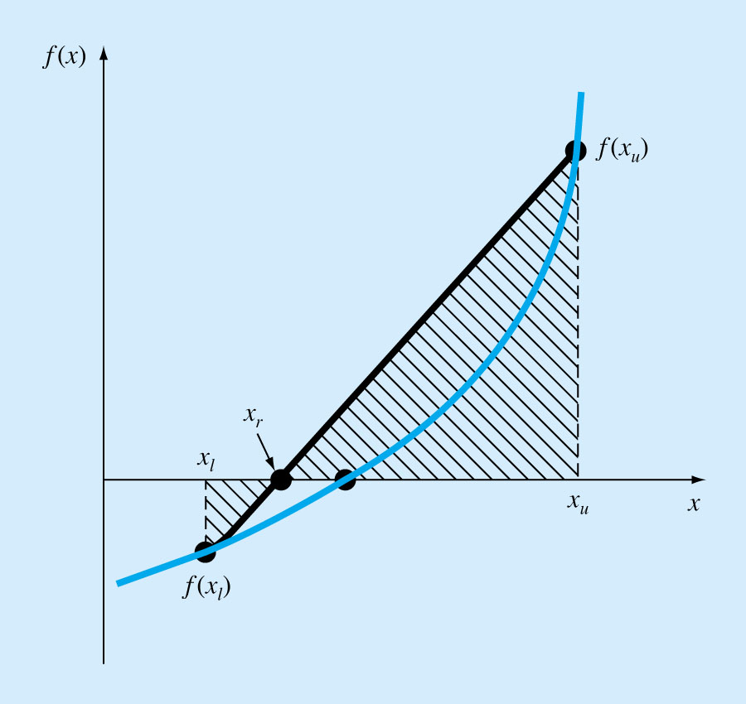
3.1.2. The False-Position Method (Regula-Falsi)
If a real root is bounded by x_{l} and x_{u} of f(x)=0, then we can approximate the solution by doing a linear interpolation between the points [x_{l}, f(x_{l})] and [x_{u}, f(x_{u})] to find the x_{r} value such that l(x_{r})=0, l(x) is the linear approximation of f(x).

Slide 31
Procedure
Find a pair of values of x, x_{l} and x_{u} such that f_{l}=f(x_{l}) <0 and f_{u}=f(x_{u}) >0.
Estimate the value of the root from the following formula.
and evaluate f(x_{r}).

Slide 32
Use the new point to replace one of the original points, keeping the two points on opposite sides of the x axis.
If f(x_{r})<0 then x_{l}=x_{r} == > f_{l}=f(x_{r})
If f(x_{r})>0 then x_{u}=x_{r} == > f_{u}=f(x_{r})
If f(x_{r})=0 then you have found the root and need go no further!
4. See if the new x_{l} and x_{u} are close enough for convergence to be declared. If they are not go back to step 2.

Slide 33
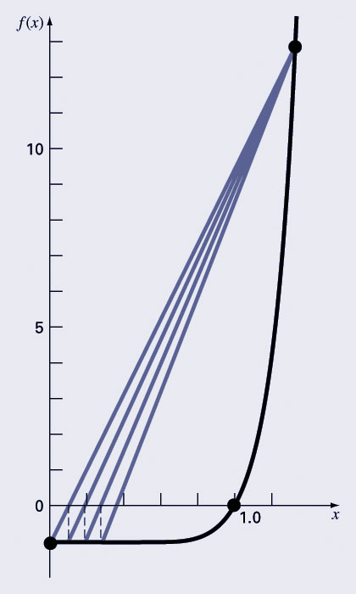
Bisection vs. False Position
Bisection does not take into account the shape of the function; this can be good or bad depending on the function!
Bad:

Slide 34
Exercise: Consider the equation cos 10x + sin(3x) = 0 implement a Matlab Script to find the roots in the interval [3, 6].

Slide 35
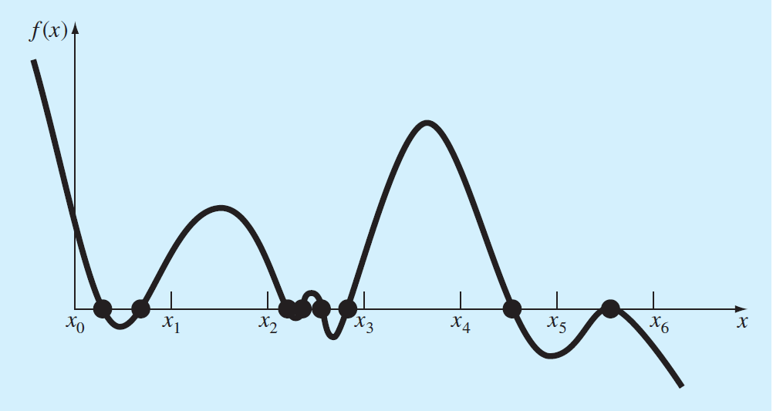
Implement a M-file to search and identify brackets within the interval [3; 6] for the function:
Incremental search

Slide 36
function xb = incsearch(func,xmin,xmax,ns)
% incsearch: incremental search root locator
% xb = incsearch(func,xmin,xmax,ns):
% finds brackets of x that contain sign changes
% of a function on an interval
% input:
% func = name of function
% xmin, xmax = endpoints of interval
% ns = number of subintervals (default = 50)
% output:
% xb(k,1) is the lower bound of the kth sign change
% xb(k,2) is the upper bound of the kth sign change
% If no brackets found, xb = [].
% Incremental search
x = linspace(xmin,xmax,ns);
f = func(x);
nb = 0; xb = []; %xb is null unless sign change detected
for k = 1:length(x)-1
if sign(f(k)) ~= sign(f(k+1)) %check for sign change
nb = nb + 1;
xb(nb,1) = x(k);
xb(nb,2) = x(k+1);
end
end
if isempty(xb) %display that no brackets were found
disp('no brackets found')
disp('check interval or increase ns')
else
disp('number of brackets:') %display number of brackets
disp(nb)
end

